Slide 1
Mutations of triangular mesh for 3d shape analysis
KYOTO UNIVERSITY INFORMATICS SEMINAR
2019/10/17
Ryo Yamada
Statistical Genetics, Kyoto Univ.

Slide 2
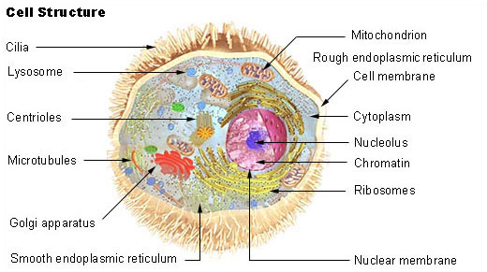
Cell
https://en.wikipedia.org/wiki/Cell_biology

Slide 3
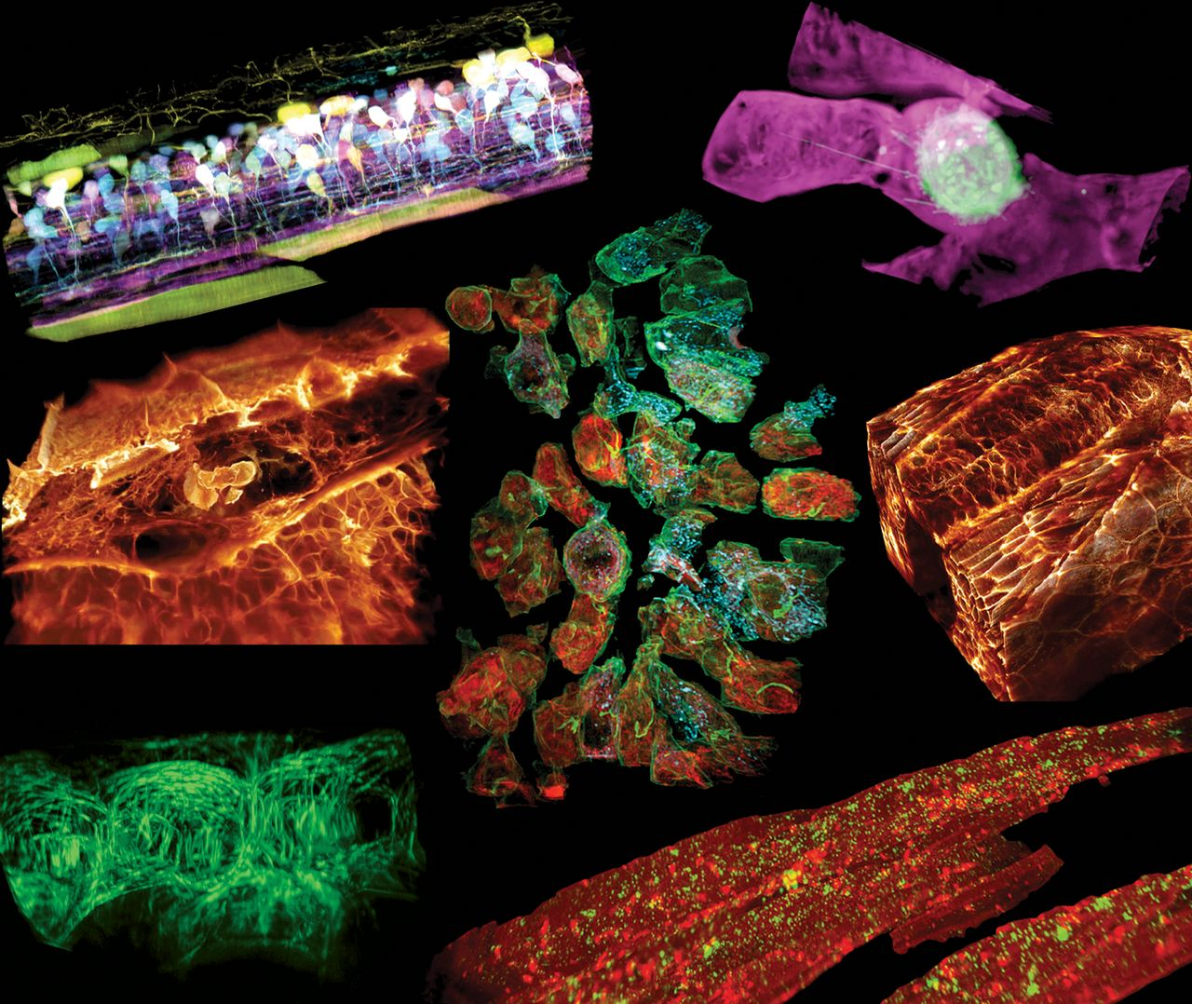
3D movie
https://science.sciencemag.org/content/360/6386/eaaq1392#media-9
Movie 9
Science 20 Apr 2018: Vol. 360, Issue 6386, eaaq1392 DOI: 10.1126/science.aaq1392

Slide 4
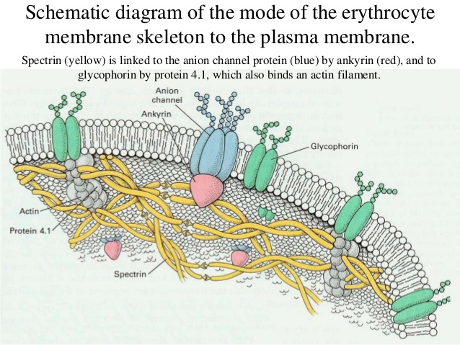
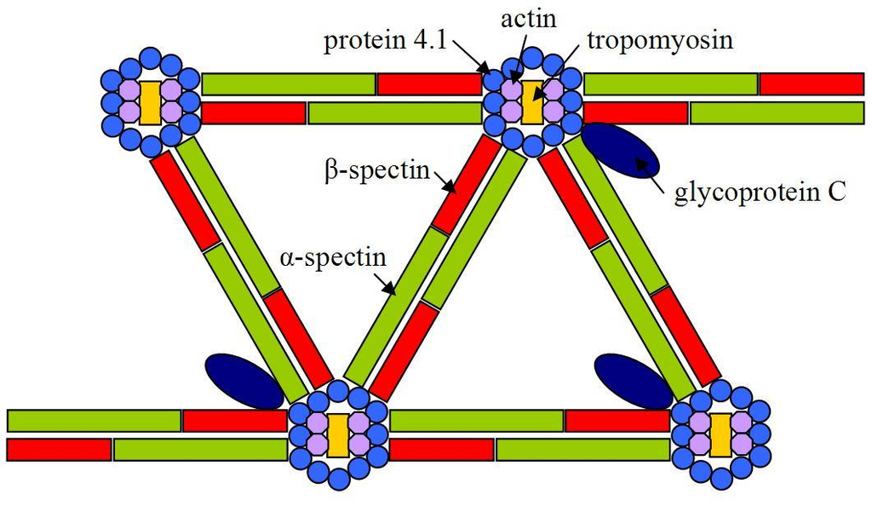
Cytoskeleton
https://www.slideshare.net/E_neutron/biological-membranes-transport-related-questions
https://en.wikipedia.org/wiki/Spectrin

Slide 5
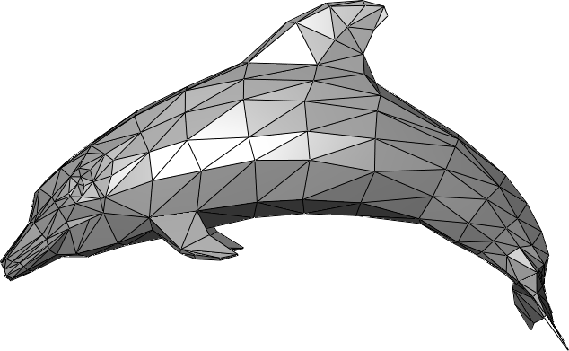
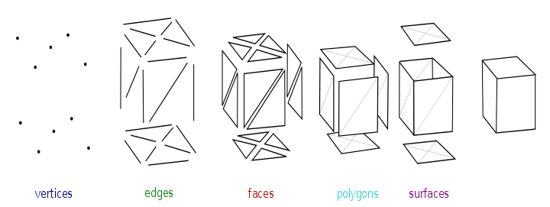
Triangular mesh
The study of polygon meshes is a large sub-field of computer raphics(specifically 3D computer graphics).
https://en.wikipedia.org/wiki/Polygon_mesh

Slide 6
Today‘s Contents
0. Triangular mesh and its dual
Quiver mutations
Variation in shapes and its stochastic representation
Quiver-based mutations to generate variation in triangular mesh
Cycles of 3-regular graph
Edge connection matrix for Ihara’s zeta function
“Straight lines” of 3-regular graph and their expression with permutation

Slide 7
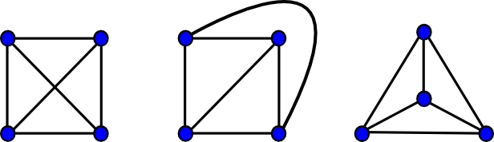
Planar graph and Euler’s formula
|V| - |E| + |F| = 2
https://www.boost.org/doc/libs/1_49_0/libs/graph/doc/planar_graphs.html

Slide 8
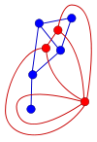
Dual Graph
Triangular mesh
Polygon
https://en.wikipedia.org/wiki/Planar_graph

Slide 9
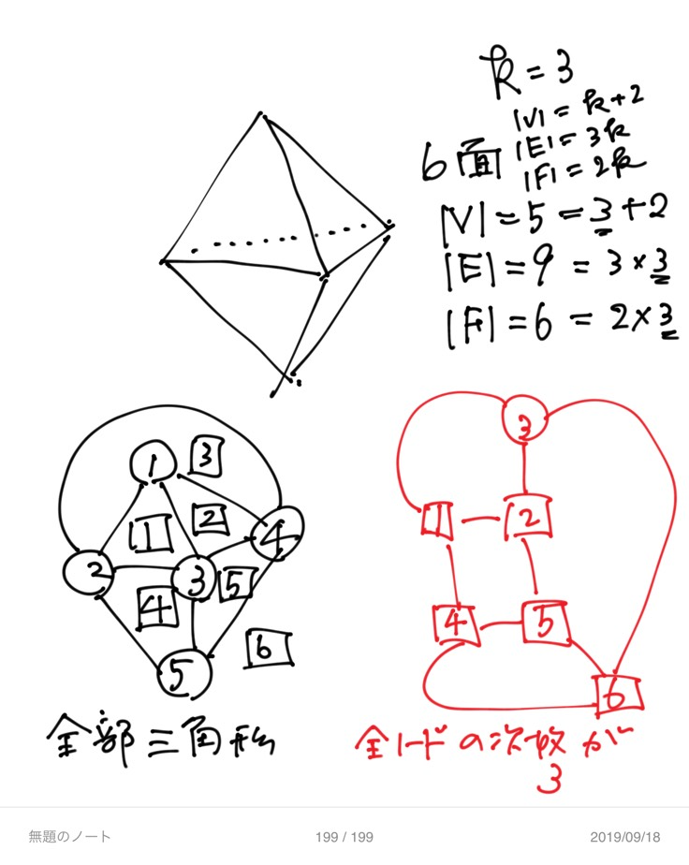
Dual graph of triangular mesh is 3-regular
Triangular mesh
All faces are triangles
Dual
Degree of all vertices are 3.
3-regular

Slide 10
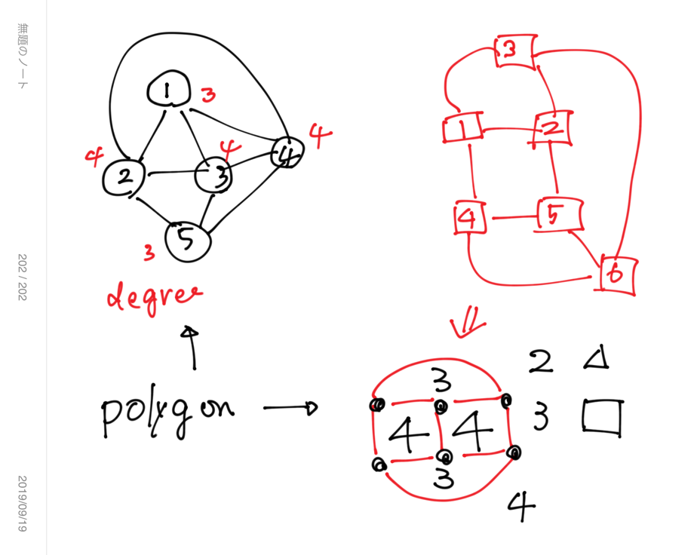

Slide 11
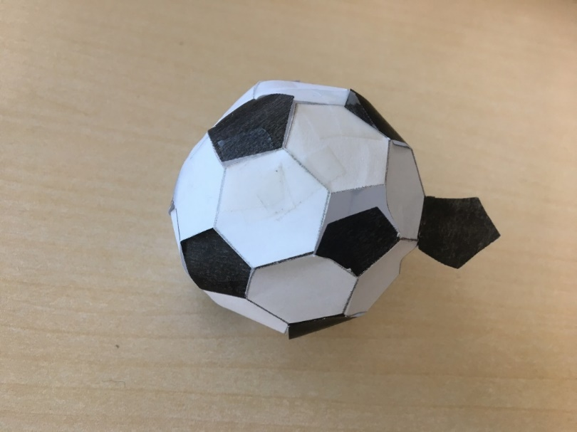
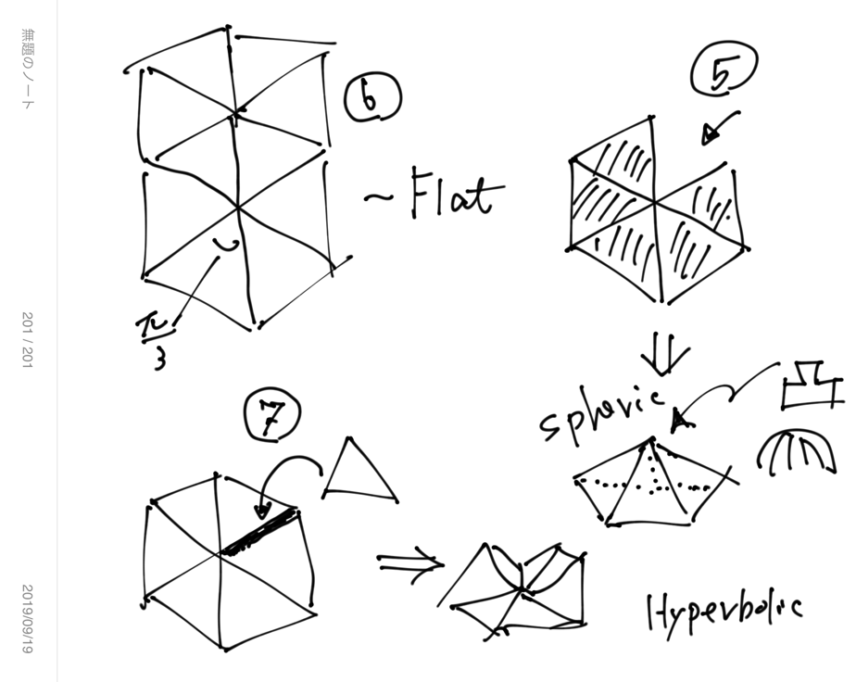
Curvature and Polygon
6 equilateral triangles make a flat plane.
< 6 equilateral triangles make concave/convex part.
> 6 equilateral triangles make redundancy of area … hyperbolic.

Slide 12

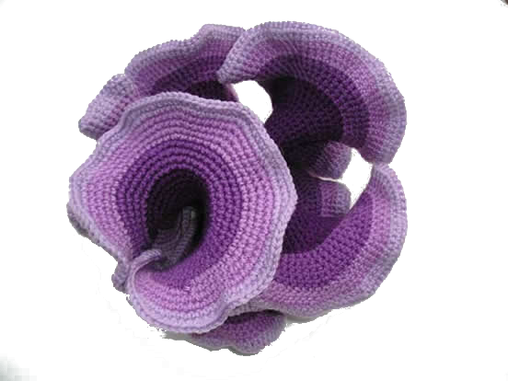
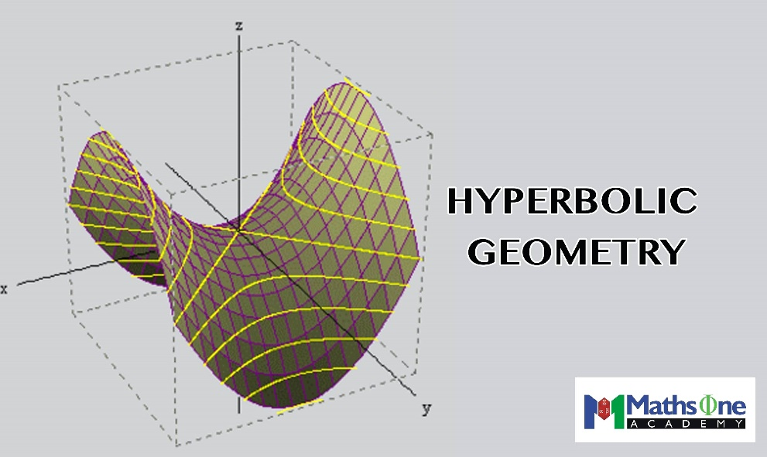
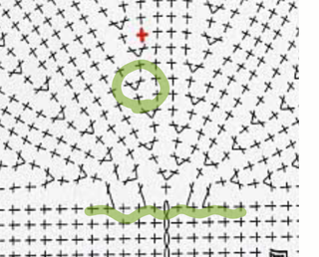
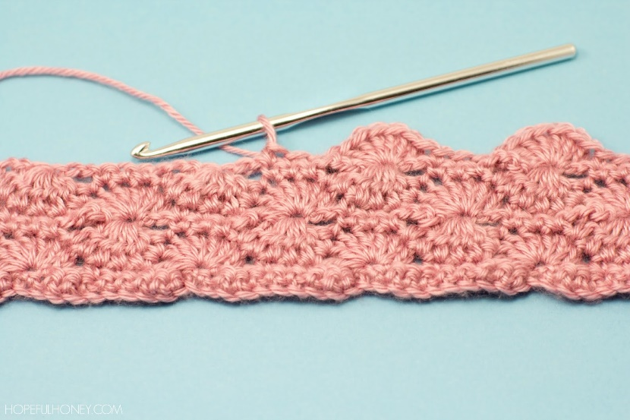
Curved surface & Croche Knitting Digital/discrete representation of curved surface
http://lugezi.com/imgs/
https://crochetcoralreef.org/contributors/daina_taimina.php

Slide 13

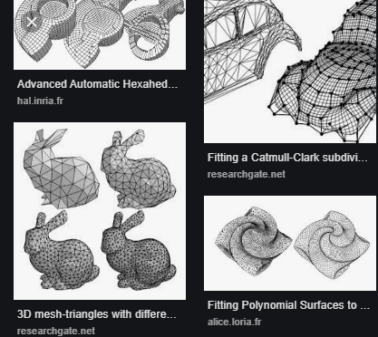
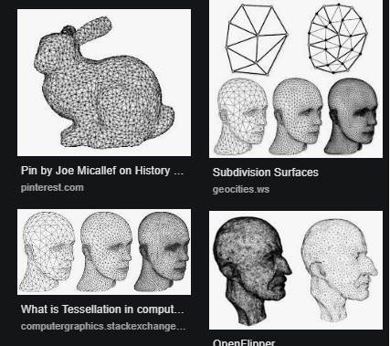
Stochastic representation of S2-isomorphic shapes
All shapes ~ Variation in triangulation…

Slide 14
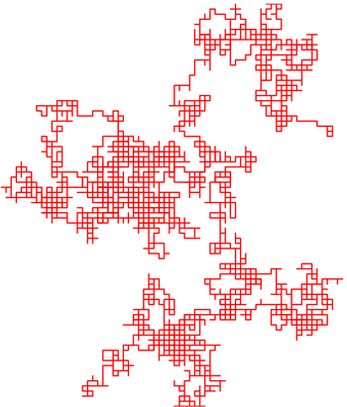
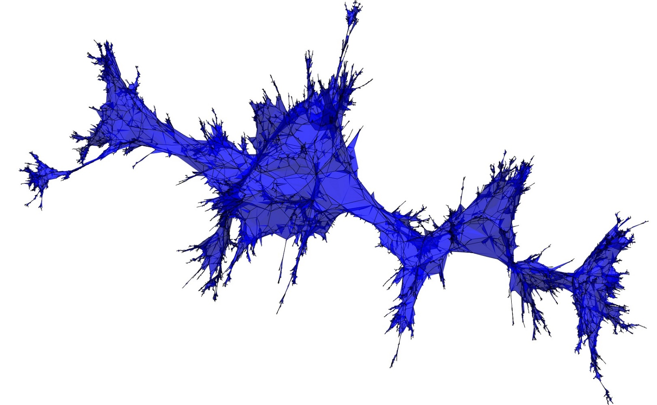
Brownian map ~ Closed surface version of random walk
https://en.wikipedia.org/wiki/Random_walk
http://bettinel.perso.math.cnrs.fr/

Slide 15
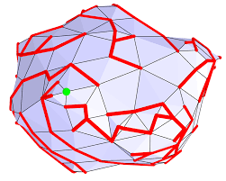
Cori–Vauquelin– Schaeffer bijection
Triangular/Quadrangular mesh has tree bijective counterpart
A random tree with random assignment of integers on branches corresponds to a random X-angular mesh.

Slide 16
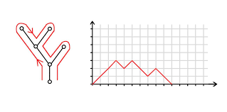
Brownian excursion 遠足 = A tree Going out and Coming back
https://uu.diva-portal.org/smash/get/diva2:653276/FULLTEXT01.pdf

Slide 17
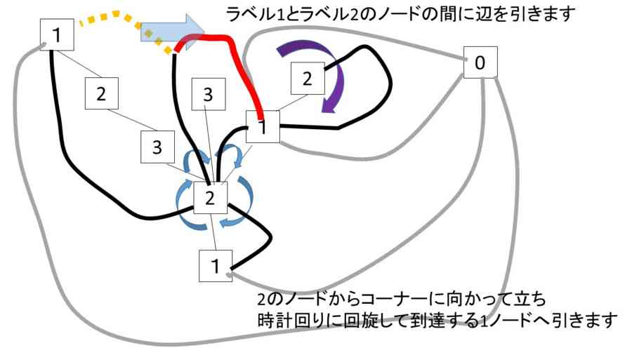
Brownian motion on tree segments assigns continuous random values on vertices
A rule to bridge two nodes based on their location and valus re-construct a triangular mesh.

Slide 18
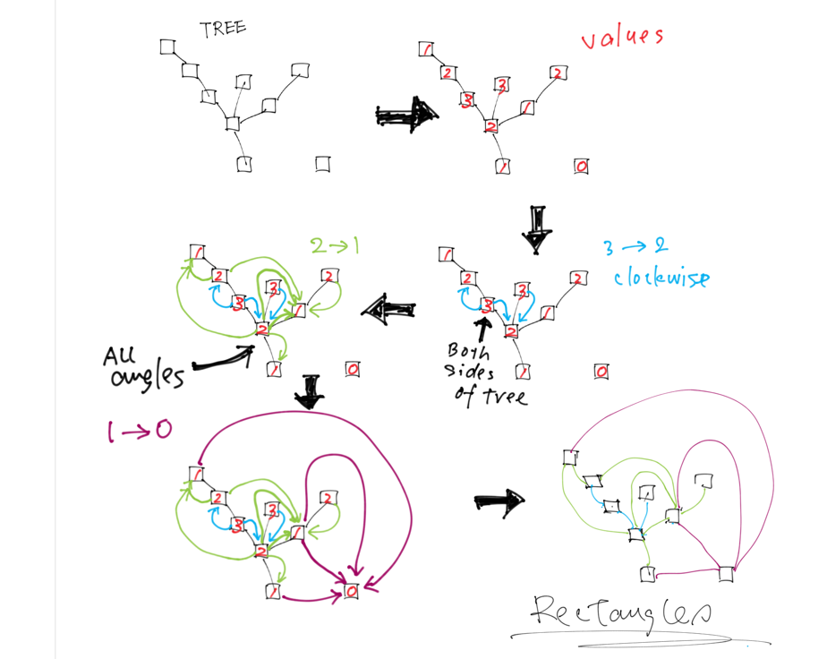

Slide 19
Different way to generate random triangular mesh stochastically??

Slide 20
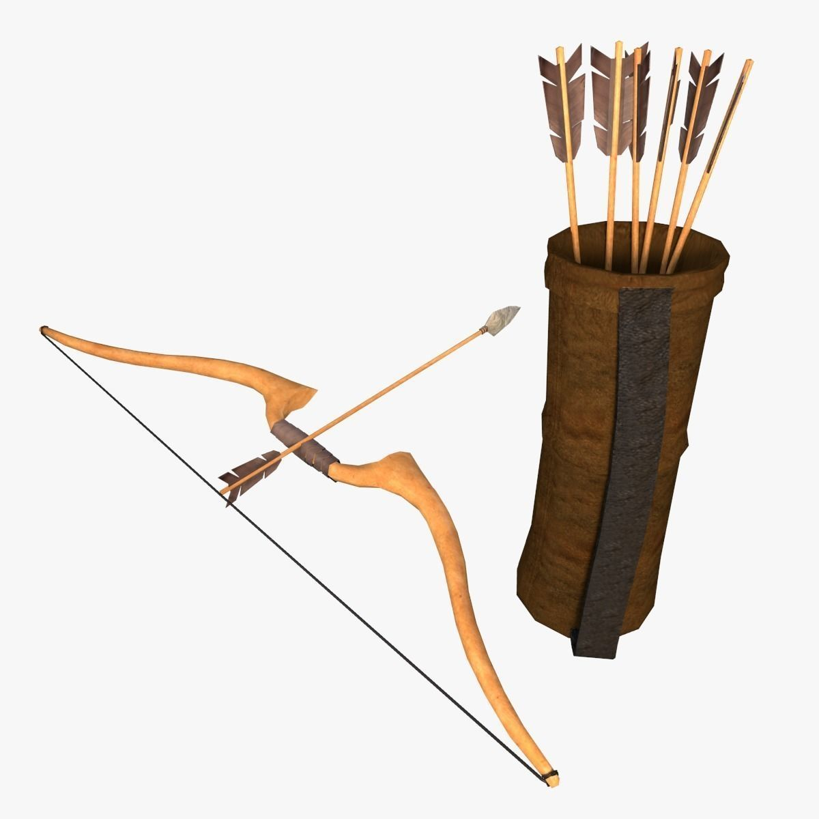
Quiver
A quiver is a directed graph, used in representation theory.
A quiver transforms to another quiver; mutation of quiver.
The mutations of quivers are accompanied by algebra called “cluster algebra”.
This feature of quivers supports mathematically sound generation of variation of quivers.
https://www.cgtrader.com/3d-models/military/other/low-poly-arrow-quiver-and-bow

Slide 21
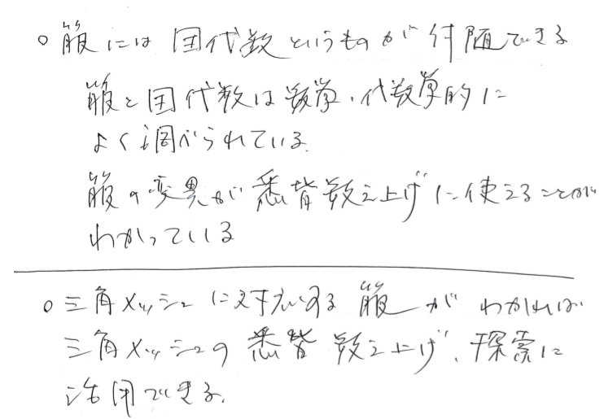
Cluster algebra
Quiver has cluster algebra.
Each vertex of quiver corresponds to one of the elements of the algebra.
Mutations of quiver changes a set of elements to another set of elements.
The whole elements and their quiver-mutational changes define an algebraic structure of them.
The elements are rational polynomials.
Cluster algebra has been applied to: Various algebraic studies, geometry, knot theory, mathematical physics …

Slide 22
Application of mutation of quiver to triangular mesh ??
If triangular meshes have their quiver expression, stochastic changes of triangular meshes can be expressed as mutations of quivers.

Slide 23
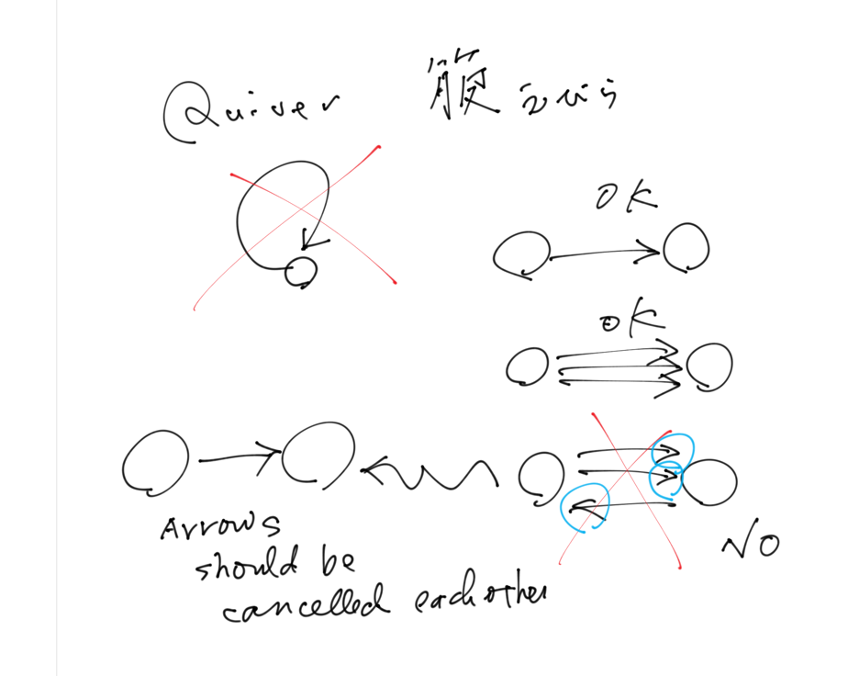
Quiver
A directed graph
No loop
Multiple edges are allowed
Edges in opposite directions should be cancelled.

Slide 24
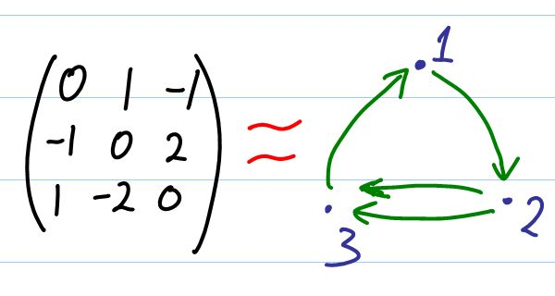
Quiver
Matrix representation
Skew-symmetric matrix (A^T = -A)

Slide 25
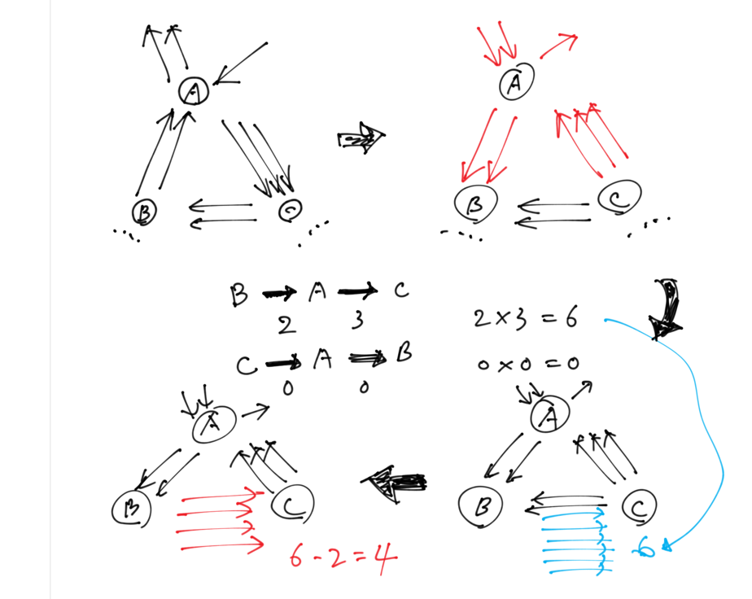
Mutations of Quivers
Select one of Vs, A.
Reverse direction of edges connecting to A.
If B and C are adjacent to A, count the number, N, of the ways to go from B to C (or C to B) via A. Add N edges between B and C.
Cancel the edges in opposite directions.
The number of veritices is the number of mutations of a quiver.

Slide 26
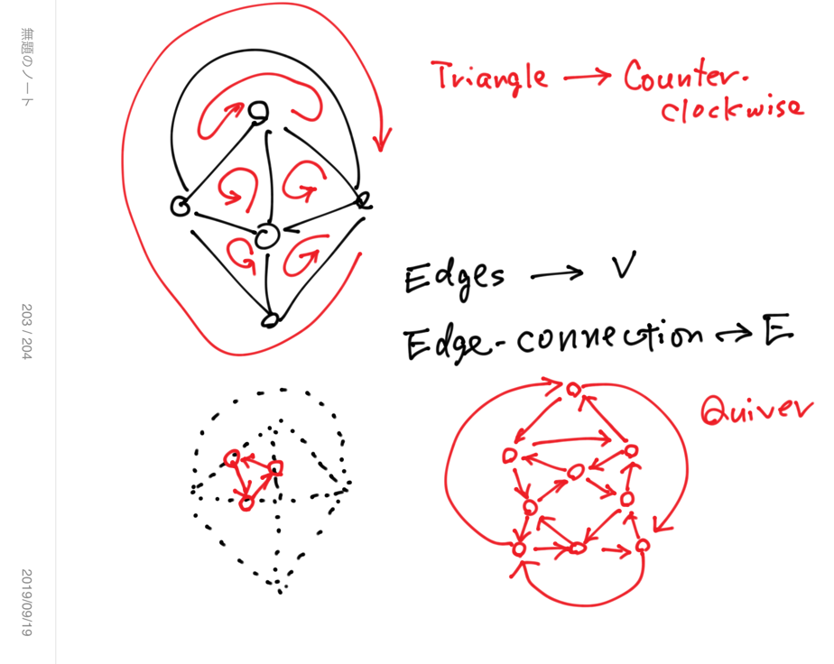
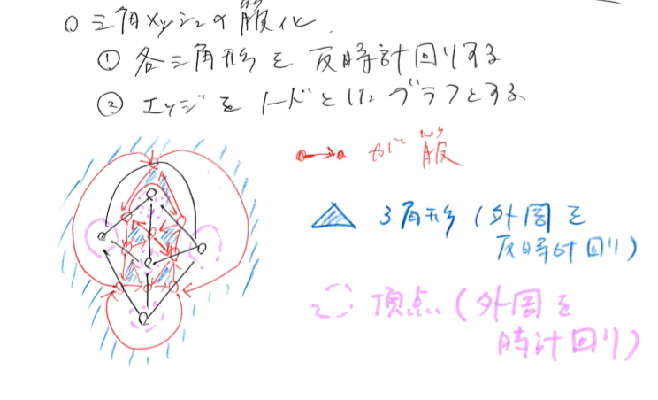
Quiver representation of triangular mesh

Slide 27
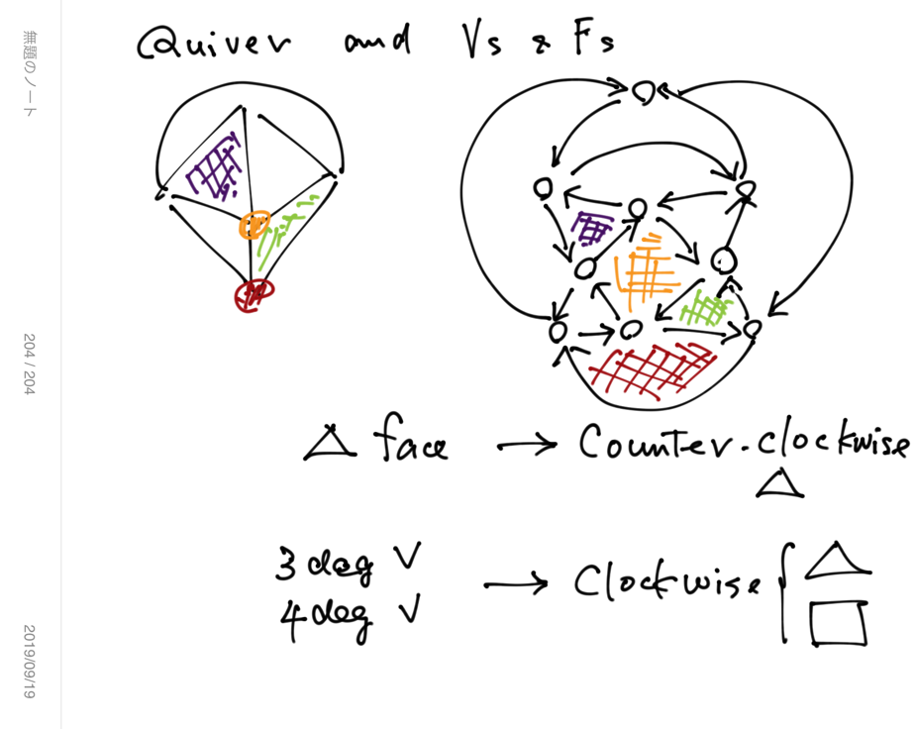
Quiver representation of triangular mesh

Slide 28
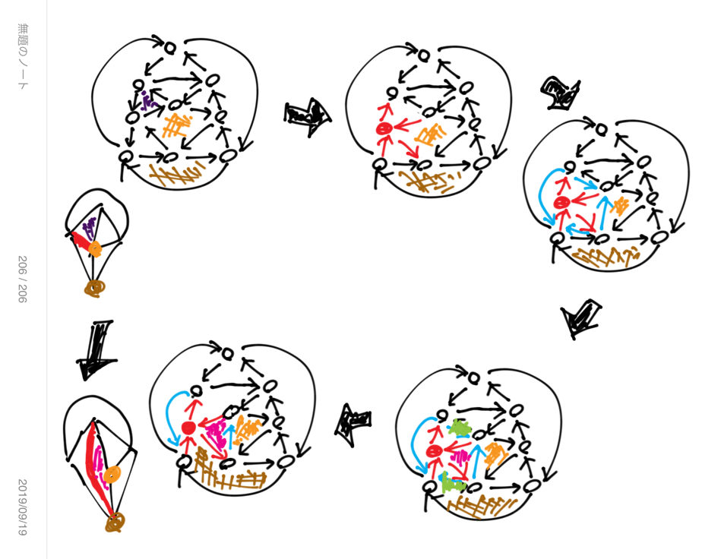
Mutation of quiver of triangular mesh

Slide 29
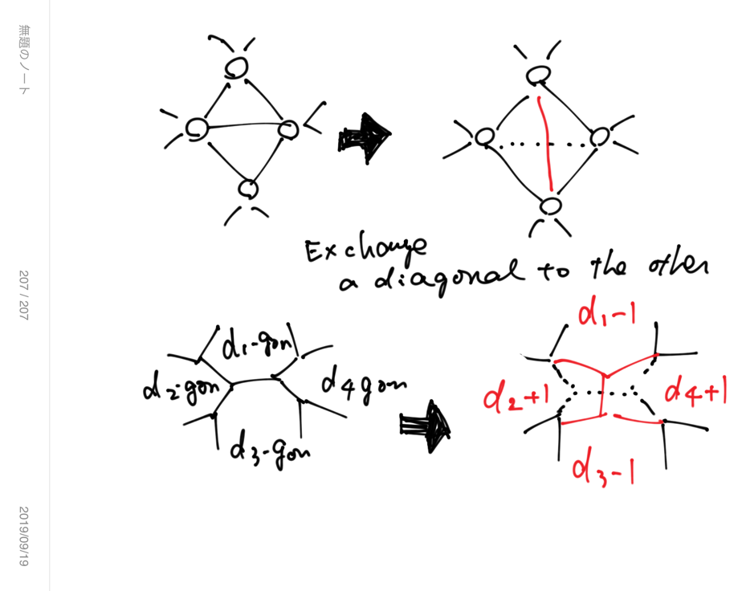
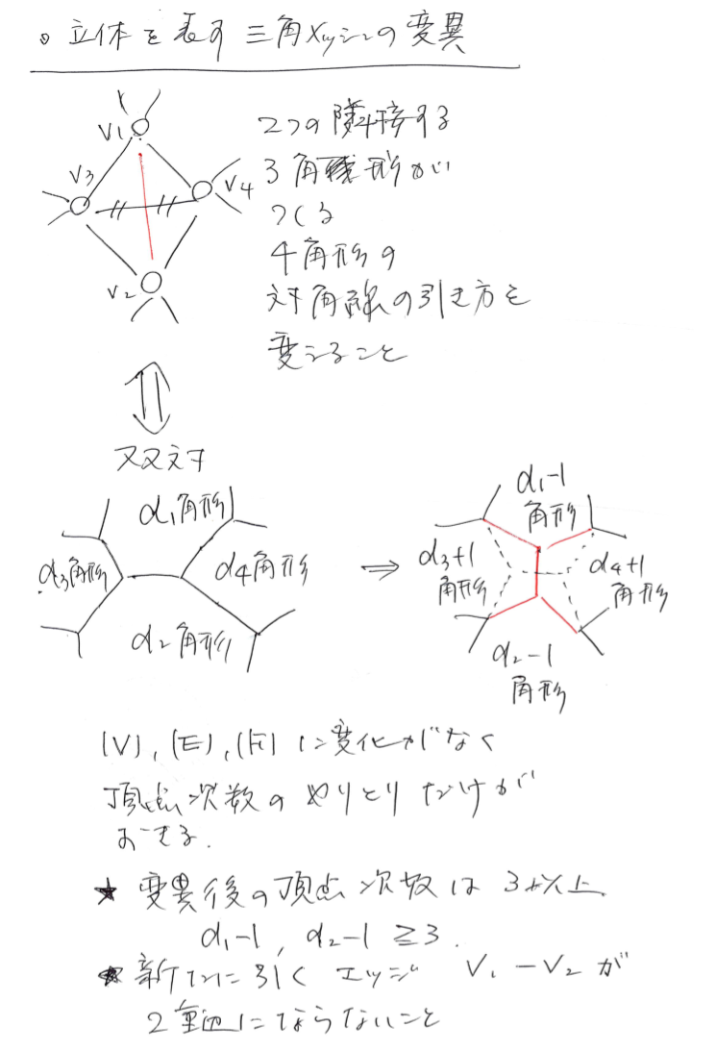
Triangular mesh
Dual

Slide 30
Enumeration of triangular meshes ??
Some quiver-mutations generate non-polyhedrons.
Quiver mutations are expressed in the language of cluster algebra.
Under some restrictions, e.g., fixed number of nodes of quiver, the number of quiver variations are finite.
Enumerative ??
Probability mass function can be assigned on the set of quivers ??

Slide 31
Remember the V-cycles and F-cycles in Quiver

Slide 32
Cycles of 3-regular graph

Slide 33
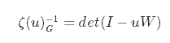
Number of cycles and Ihara’s zeta function
Backtrack-less cycles of graph
Ihara’s zeta function is a moment-generating function of bachtrack-less cycles.
W is a edge connection matrix a graph.
Explanation of W follows.

Slide 34
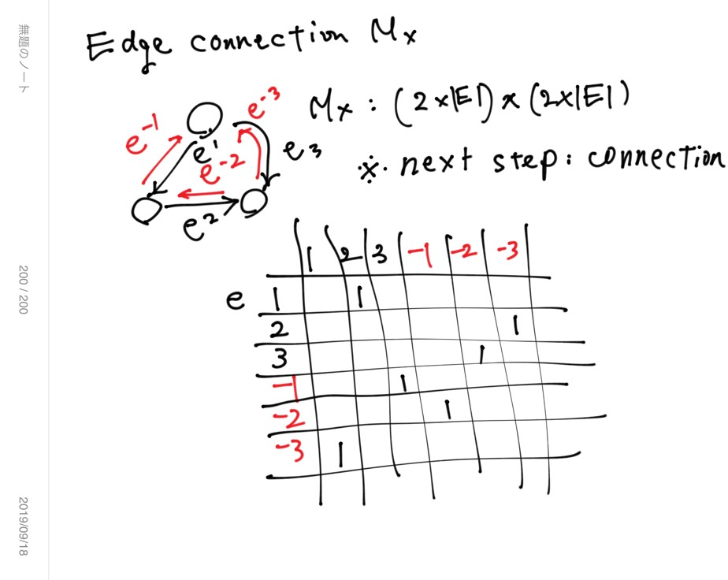

Slide 35
Edge connection matrix
|V| = k + 2, |E| = 3 k, |F| = 2 k
Edge connection matrix W : (2 |E| ) x (2 |E| )
Double edge and make a directed graph with 2 |E| = 6 k edges.

Slide 36
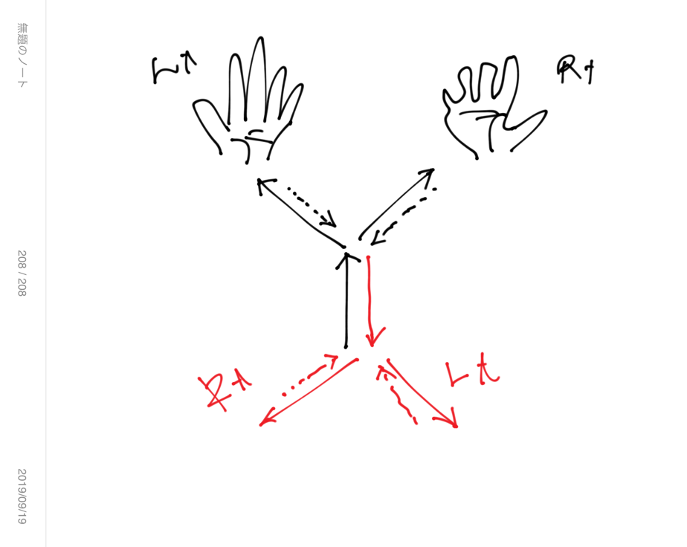
Two ways to go
Each directed edge is connected to two edges: Left and right ways.

Slide 37
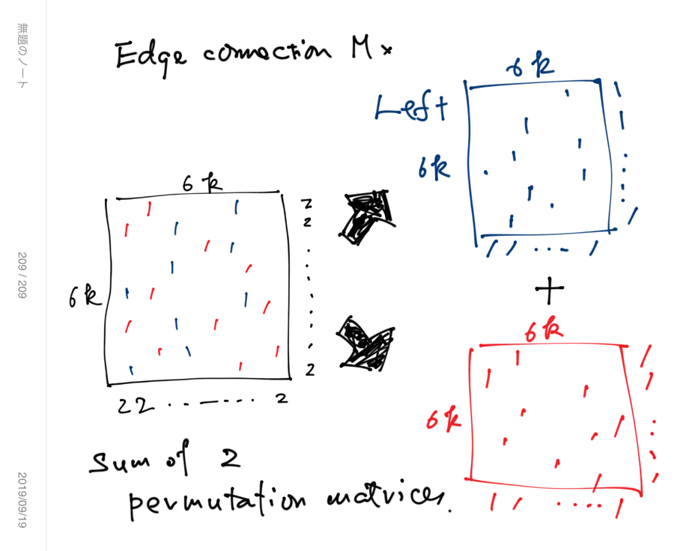
Edge connection matrix is the sum of two permutation matrices.
Left way connection and right way connection.

Slide 38
When we concern all cycles of 3-regular graph,
We have to use W = W(left) + W(right), but…

Slide 39
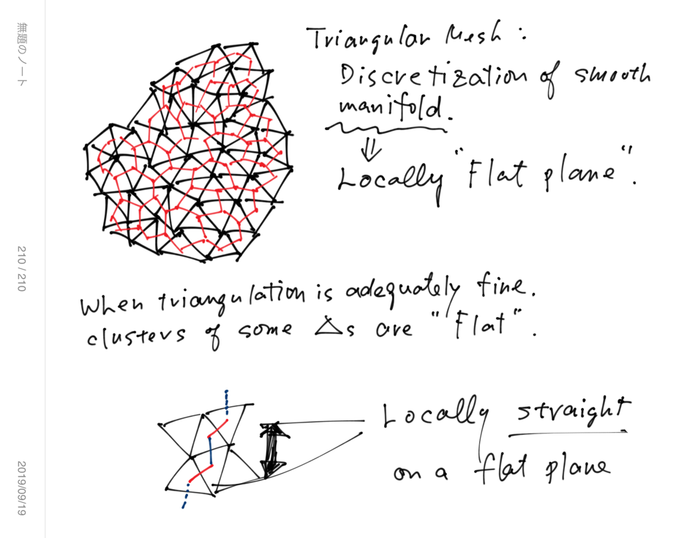
Locally straight line
Left -> Right -> Lt -> Rt -> Lt ->Rt
Connection of locally straight line segments.
Zig-Zag paths are somehow straight on triangular mesh.

Slide 40
Zig-Zag paths
W(L) W(R) W(L) W(R) … = (W(L) W(R))^n
Matrix expression of zig-zag paths.
W(L) W(R) : a product of 2 permutation matrices
W(L) W(R) is another permutation matrix.

Slide 41
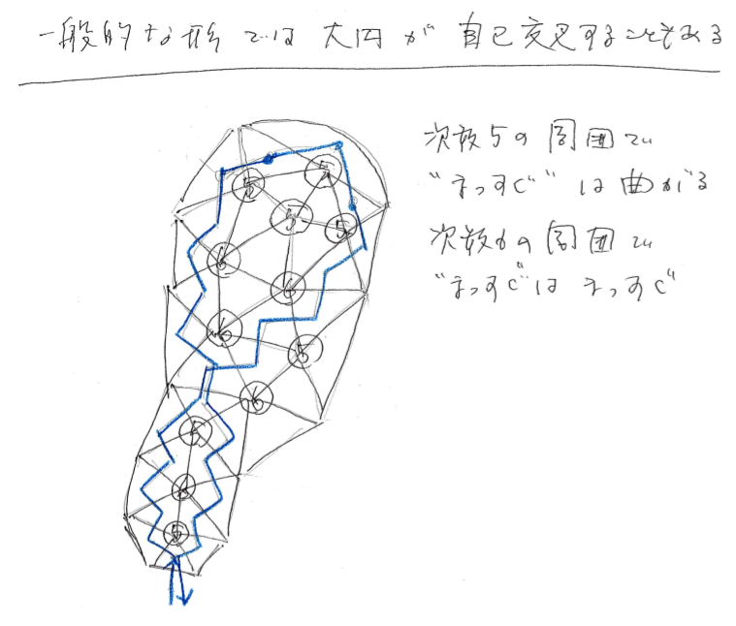
Zig-zag paths (“straight line) may intersect themself.
A zig-zag path goes through the area with many vertices whose degree < 6, tends to make a cycle and self-intersection.

Slide 42
(W(L) W(R) )
Defines 1 or more zig-zag cycles.
Every directed edge among 6k edges appears twice in the zig-zag cycles.
The length of zig-zag cycles and their crossing pattern depend on W(L) and W(R), that represent curvature-related feature of the triangular mesh.

Slide 43
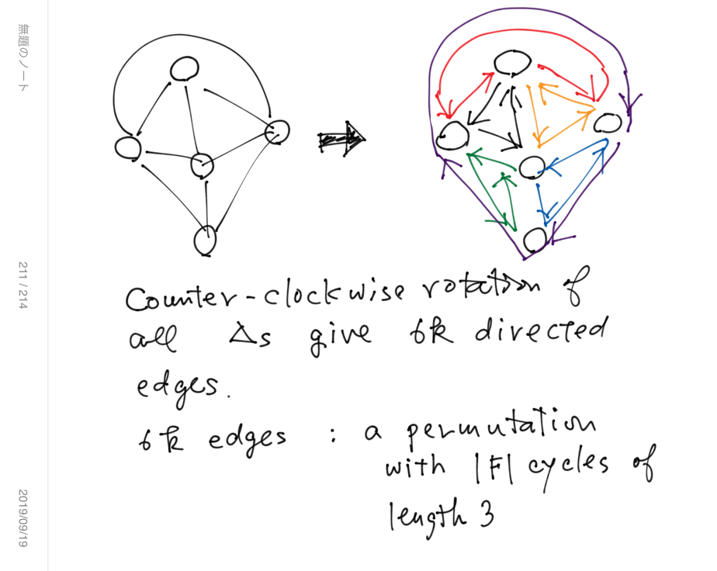
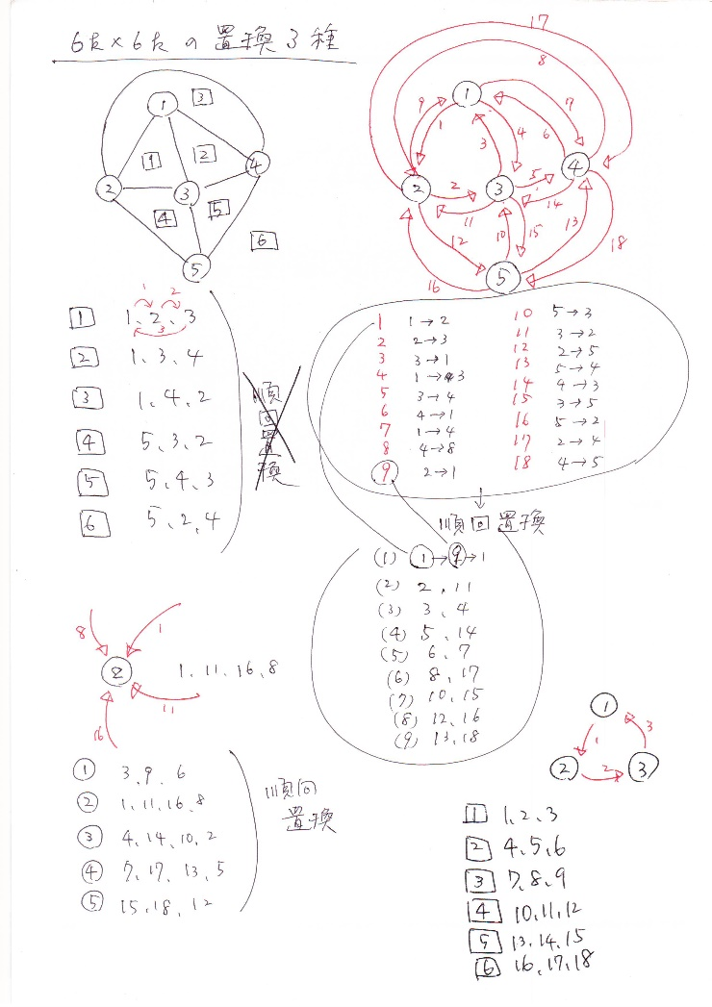
Permutations of triangular mesh and its related graphs

Slide 44
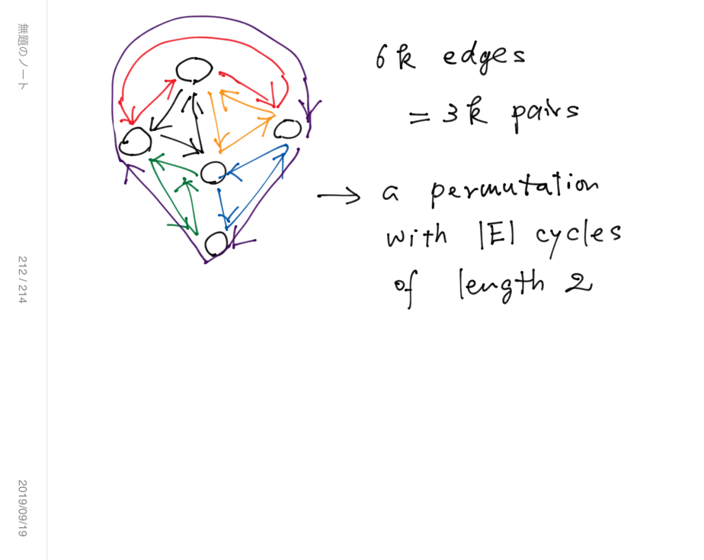

Slide 45
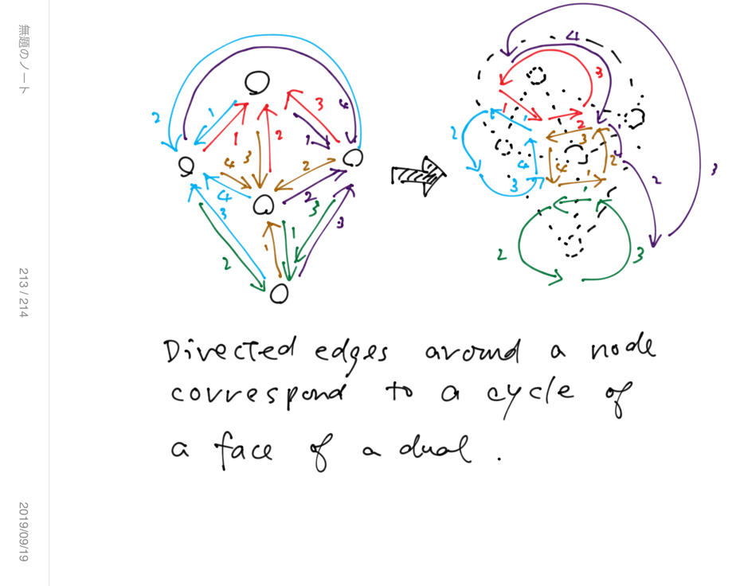

Slide 46
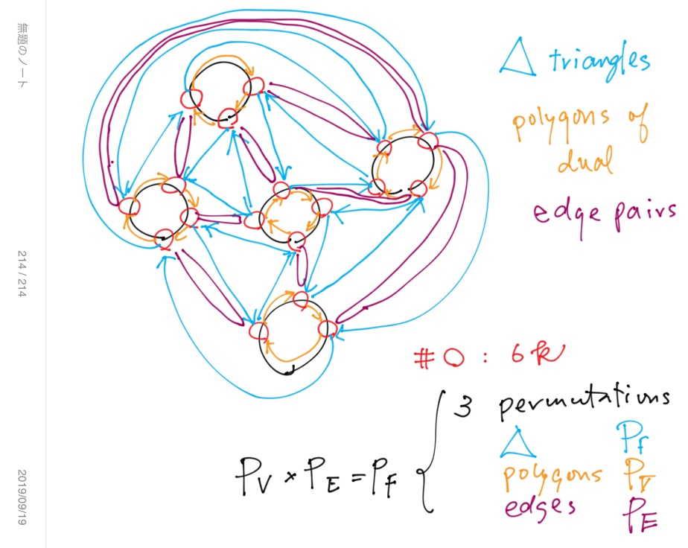
Relation among 3 permutations

Slide 47
Quiver has P(F) and P(V)

Slide 48
Summary: Permutations and Shapes
3D shape ~ triangular mesh
Triangular mesh and its dual are both polyhedron and planar graphs.
They have three mutually related permutations for Vs and Es and Fs.
Quiver of triangular mesh has 2 of 3 permutations.
Mutations of quiver provides the way to generate variation of triangular mesh with algebraic structure.
The feature of curvature of triangular mesh is expressed as permutation.

Slide 54
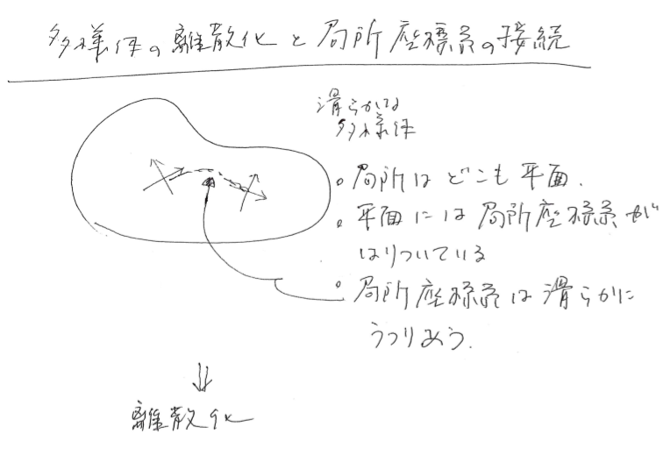

Slide 55
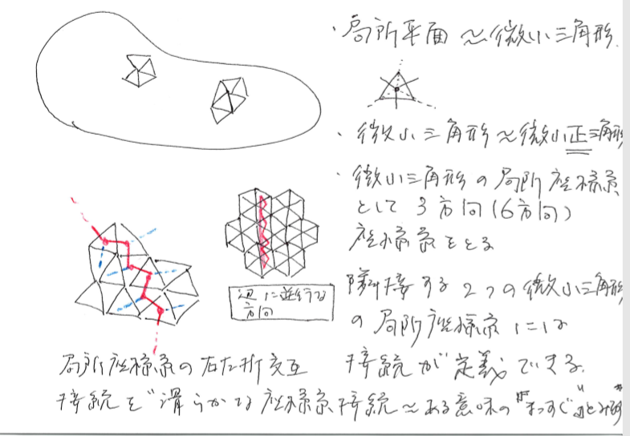

Slide 56
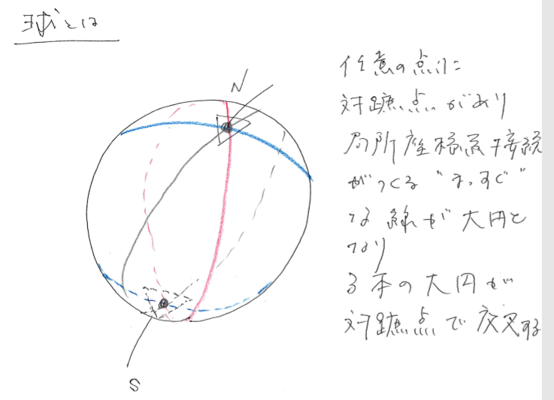

Slide 58
Shape(凹凸), Curved surface(凹凸ナシ、伸び縮みのみ)

Slide 59
Contents
Triangular mesh and its dual
Curvature and its discrete expression
Stochastic representations of shapes
Quiver and cluster algebra
Stochastic change of triangular mesh as mutation of quiver
3-regular graph and edge connection matrix
“Straight line” of 3-regular graph
Straight lines are a permutation

Slide 60
Random planar curves and Schramm-Loewner evolutions
https://www.youtube.com/watch?v=NkdlqW1hmlY
Driven by one-dimensional random walk

